Slide 1
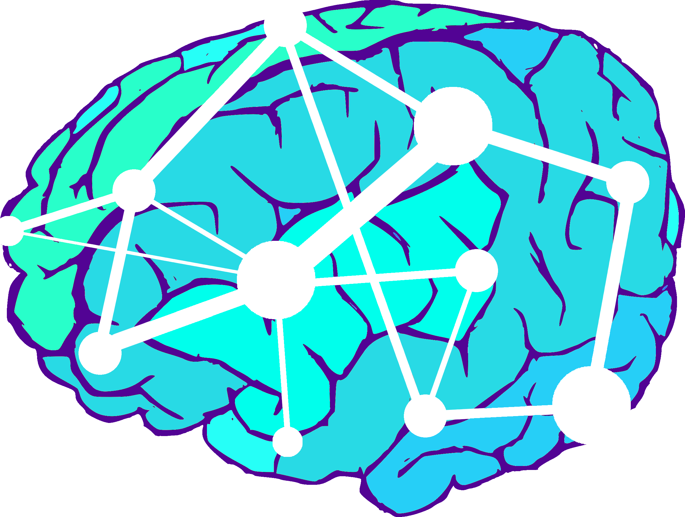
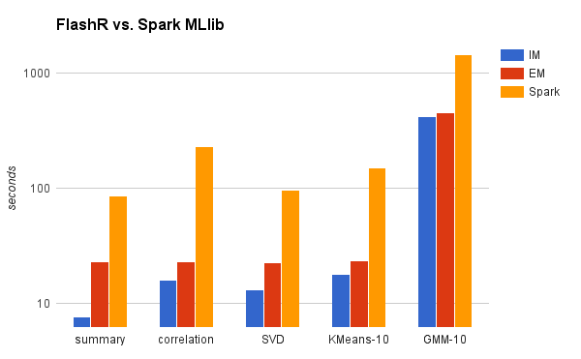
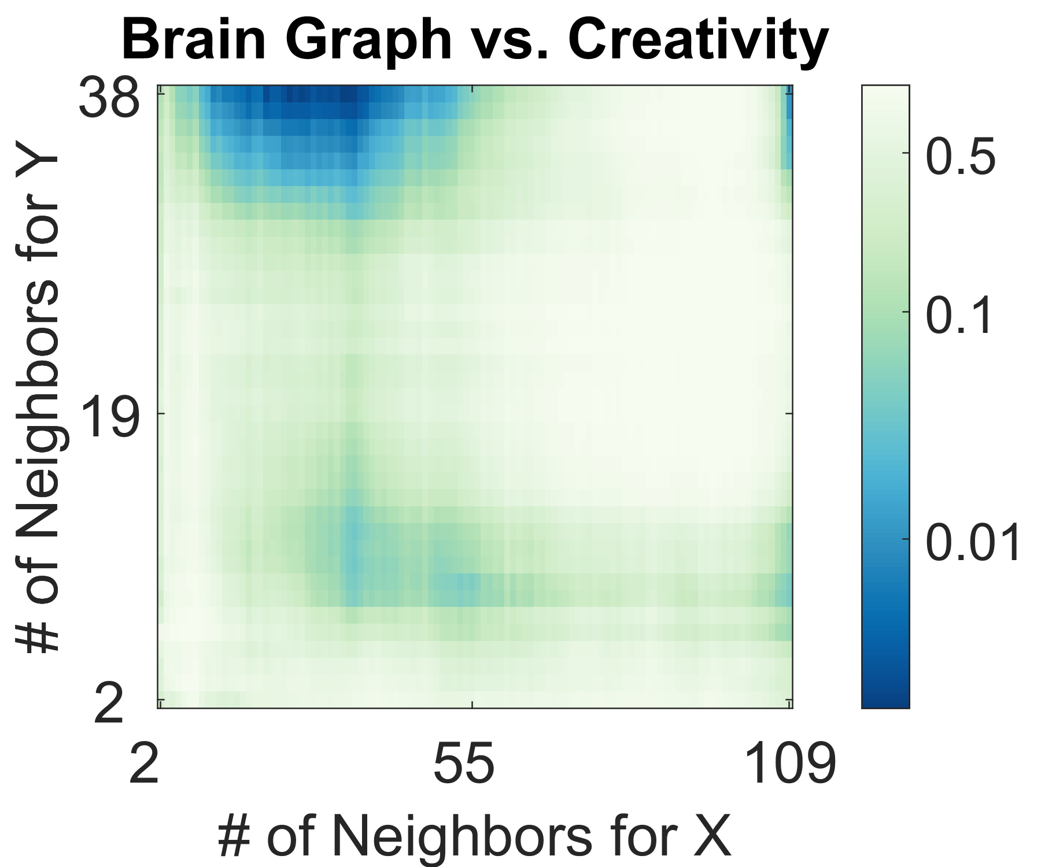
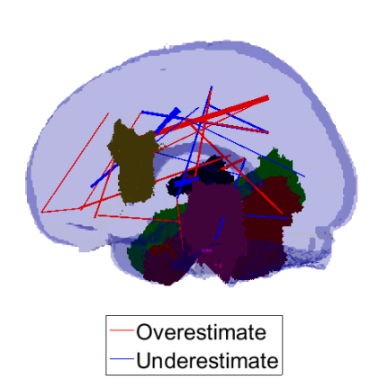
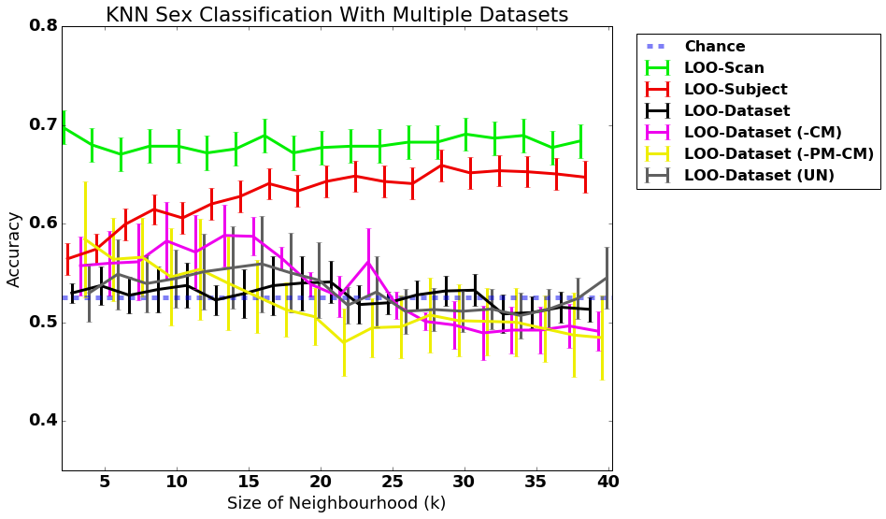
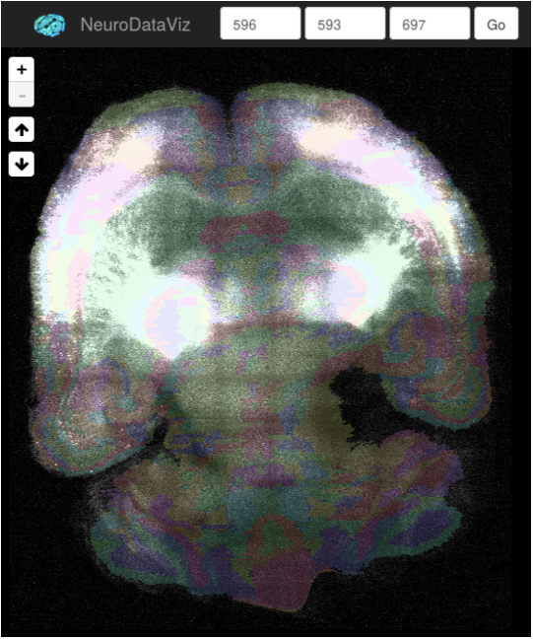
JHU SIMPLEX: Enabling Terascale Neuroscience for Everyone
(1) FlashX for Data Science
Added a variety of generalized matrix operations to FlashX
This enables many basic data science routines to be written in native R code but scale to arbitrarily big data on a single machine
http://flashx.io/
(2) MGC 2-Sample Testing
Extended previous 2-sample testing (dcorr) by sparsifying graphs
We now have theory and methods (in MATLAB and R) that statistically dominates the previous best method
Use in several novel neuroscience applications to discover the scales of dependency
https://github.com/jovo/MGC
(3) Law of Large Graphs
Proved spectral regularization is more efficient than naive estimate of of average graph
Proved robust variant is even more efficient in the presence of outliers
Demonstrated on real data to discover false positives and negatives in previous estimates of mean connectome
https://github.com/jhu-graphstat/LLG
(4) MR Batch Effect
Using data data and pipeline from GRAPHS, discovered the existence of batch effects
Simple linear approaches to removing batch effects failed
Extending now to nonlinear models
http://m2g.io
(5) CLARITY
Multimodal LDDMM for registering CLARITY to Atlas and other CLARITY brains
Distributed ROI histogram Web-service
Ingested 12 ~1TB CLARITY brains and registered them each to Allen Atlas
https://github.com/neurodata/ndreg
In summary, we provide a suite of tools and techniques which extend the boundaries of scientific discovery

Slide 2
FlashX for Data Science
Semi-external memory model for graph traversal & machine learning
Store big data matrix on SSD, store necessary sufficient statistics in RAM, eliminate the communication bottleneck.
1 big-memory node can running FlashX outperforms a 300 node cluster running MLlib
For each experiment, n=1B, p=32,
summary computes: min, max, mean, L1 norm, L2 norm, nnz
 | Compuation | I/O
Summary | n*p | n*p
Correlation | n*p^2 | n*p
svd | n*p^2 | n*p
k-means | n*p*k | n*p
gmm | n*p^2*k + p^3*k | n*p + n*k

Slide 3
MGC for 2-Sample Testing
2-sample testing is the first step in many data science problems
Multiscale Generalized Correlation (MGC) is the first approach that works well in high-dimensions, low sample size, arbitrary objects (shapes, graphs, time-series), and provides insight into scales of dependency.
Combined ideas from correlation testing and manifold learning
First theory to prove statistical dominance, meaning that we are always better than (or at least as good as) previous methods.
Figure shows that groups of neighbors in graph space are locally dependent on creativity
Global method (top right corner; special case of MGC) is very fragile: 1 missing sample destroys significance

Slide 4
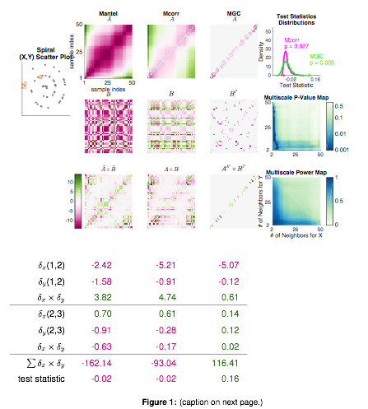

Slide 5
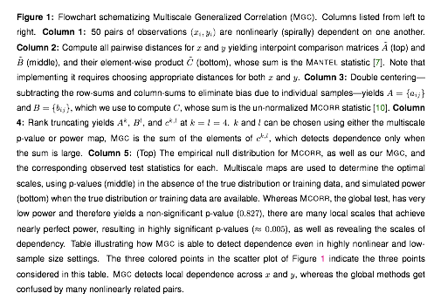

Slide 6
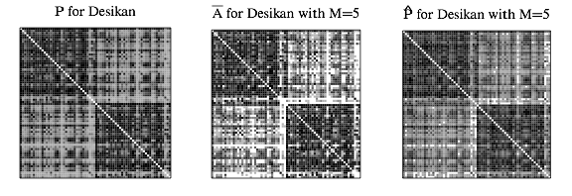
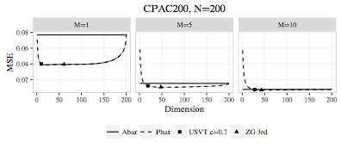
Law of Large Graphs
Average connectome is a key result of the $40M Human Connectome Project
For nearly all studies, sample size is small, and for all clinical studies, cohort size is even smaller (~5)
Proved our low-rank estimator is asymptotically more efficient (smaller errorbars) than the naive estimator
In practice, our low-rank estimator for connectomes yields better estimates whenever sample size is < 10 (which is typical)

Slide 7
MRI Batch effect
Batch effects are sources of variance due to experimental conditions
For clinical utility, batch effects must be mitigated
Removing batch effects is the key statistical step to move from research to clinic
We demonstrate using 15 different datasets processed the exact same way that batch effects completely eliminate signal
Standard methods for batch removal failed

Slide 8
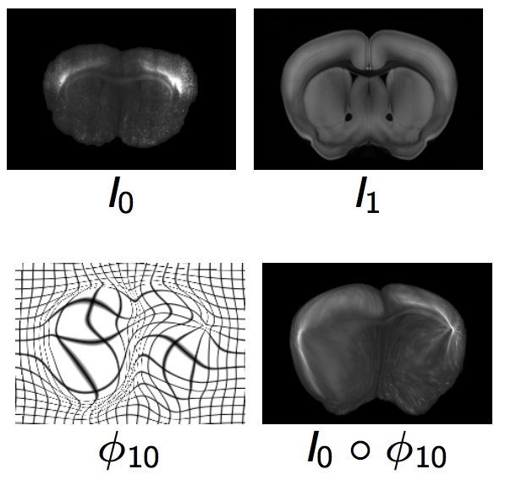
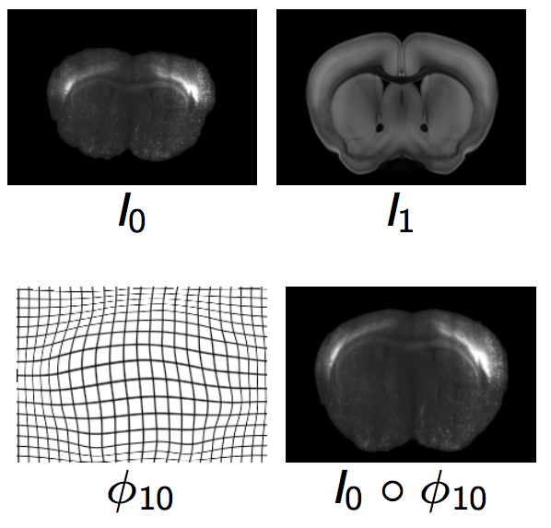
Multimodal Nonlinear Registration
CLARITY brains are increasingly important
Registering to one another and histology atlases is key to understanding
Multimodal data are bright in different places
Squared Error Nonlinear registration (LDDMM) maps bright spots to bright spots, which fails (top figure)
Mutual information LDDMM solves this problem (bottom figure)

